Slide 1


Slide 2
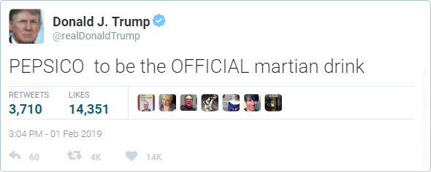

Slide 3
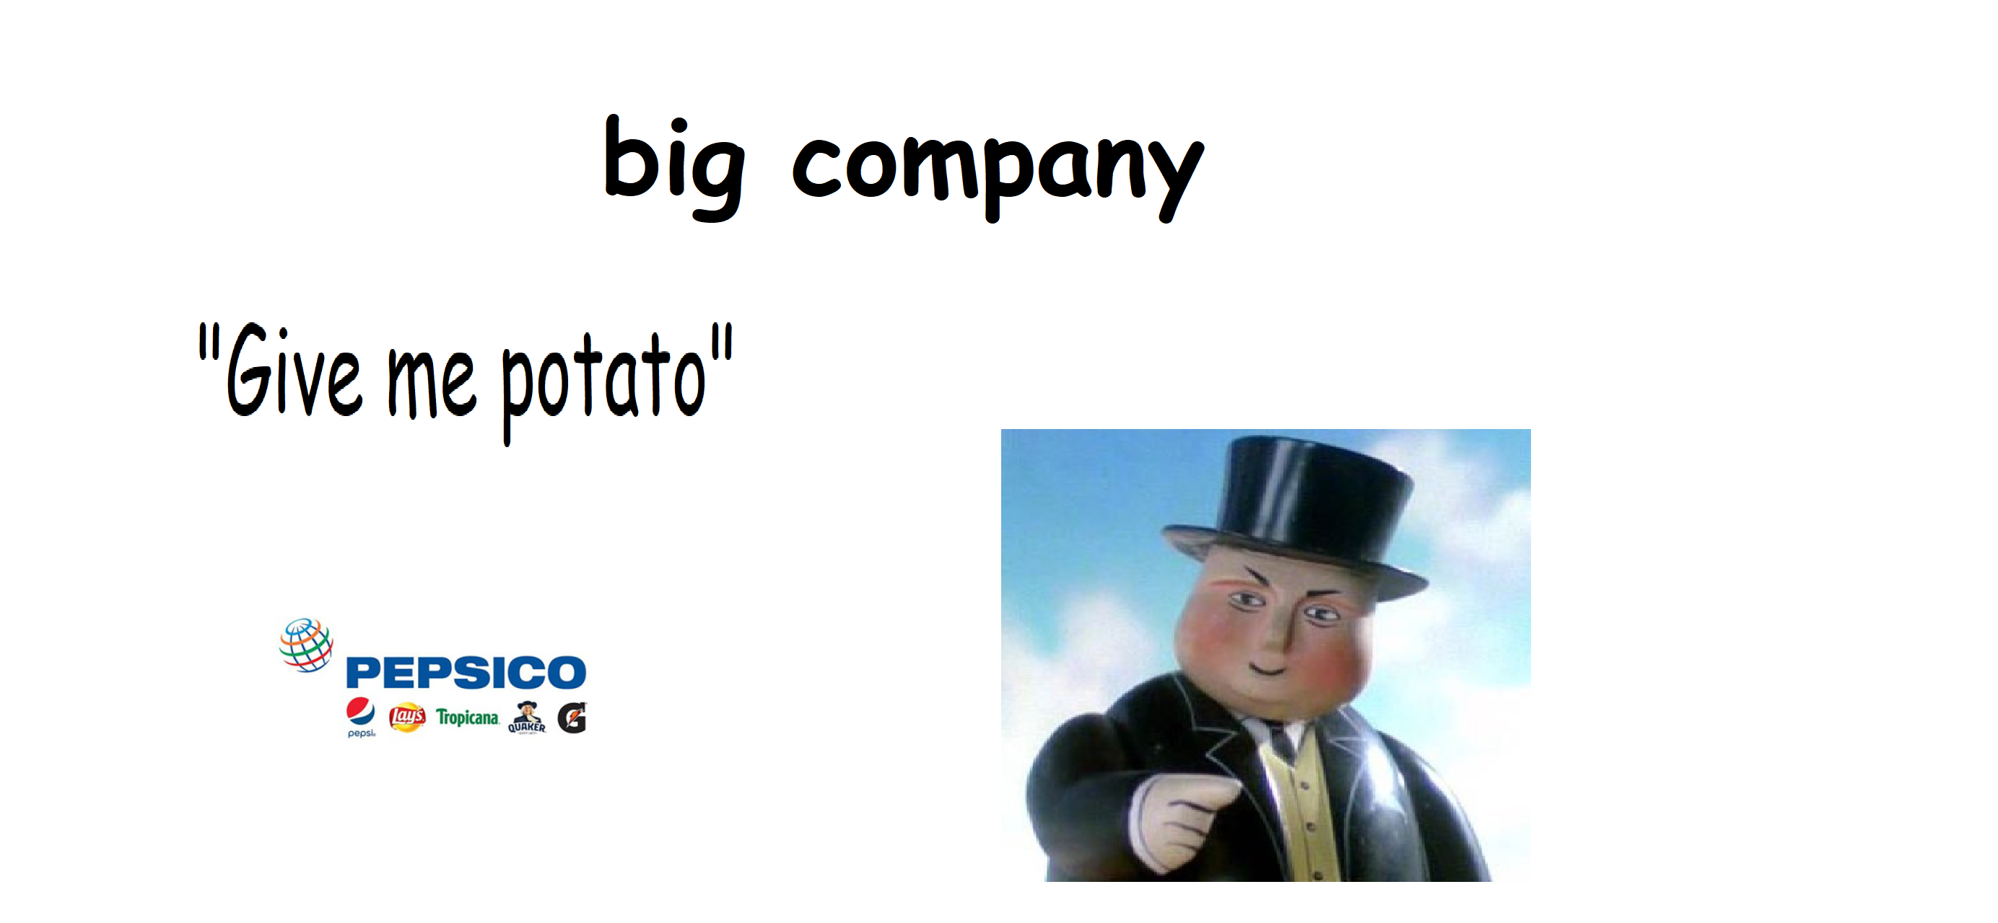

Slide 4



UNSW PEPSICO - UPOP
“UNSW to employ Volunteers in the potato fields”
- Supreme Chancellor

Slide 5

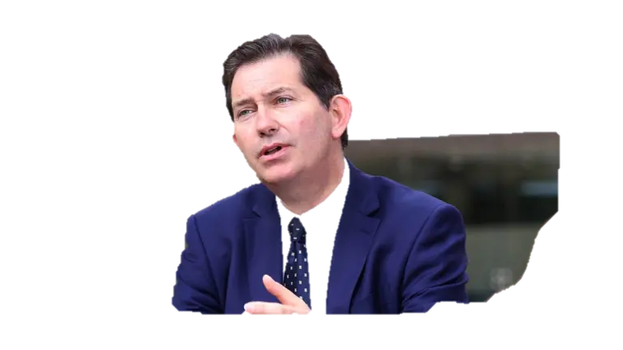
PEPSICO

Slide 6
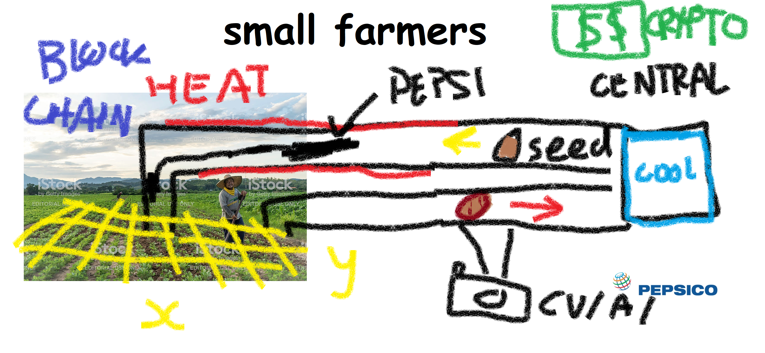

Slide 7
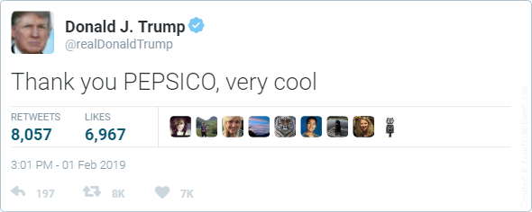

Slide 8
credits
A long time ago, in a galaxy far, far away
Some bored guys, dozing away

